Slide 1
DYNAMIC ASSET ALLOCATION
(DETECTING REGIME & ASSET ALLOCATION)
Group 5
Kanghyun Lee
Muhammet Furkan Isik
Advisor : M.Pape Ndiaye

Slide 2
AGENDA
INTRODUCTION
DESIRED OUTCOMES
MODEL FRAMEWORK
DATA & METHODOLOGY ( LABELING)
NEURAL NETWORKS
OPTIMIZATION
RESULTS & COMPARISONS

Slide 3
INTRODUCTION
Asset Allocation is an art of distributing limited resource optimally
Modern Portfolio Theory suggest Mean-Variance based asset allocation single period
- Markowitz aims to maximize expected return of the portfolio with given risk level
Regime : The economic state of the market for given period
- Volatility clustering
- Sentiment, Hard mentality, Monetary Policy
Optimal Asset Allocation requires detecting market regime
- No need to rebalance frequently, rebalance when market condition changes
- Adjust target beta in accordance with the market condition

Slide 4
DESIRED OUTCOME
Market Regime( State)Classification
Dynamic Portfolio Allocation; proactively adjusting the portfolio assets
Stable Return, Lower Volatility, Higher Sharpe Ratio, Lower Max DD

Slide 5
MODEL FRAMEWORK

Slide 6
Dynamic Portfolio Allocation
Regime Detection
Optimization
Fama- French 3 Factor Model
Input Selection
Output Labeling
Threshold Value
Return Estimation
Cov- Var Estimation
Allocation Strategies
Deep Learning
RNN LSTM
Performance Comparison

Slide 7
METHODOLOGY
DETECTING REGIME USING NEURAL NETWORK ( VOLATILE vs NON-VOLATILE)
ADJUSTING PORTFOLIO ALLOCATION ACCORDINGLY

Slide 8
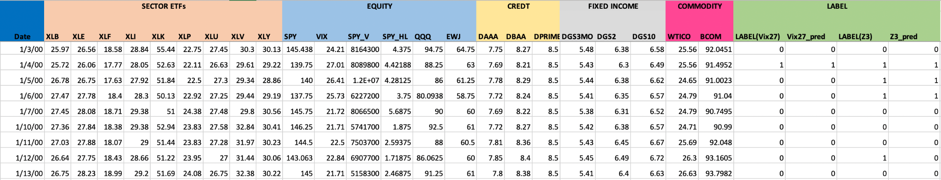
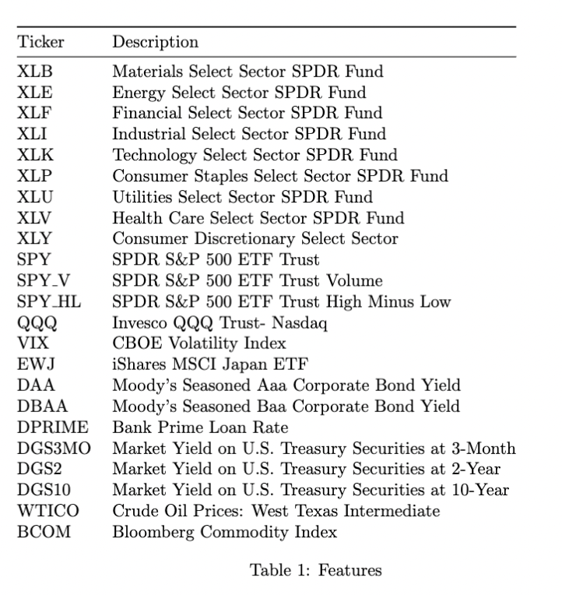
DATASET

Slide 9
NEURAL NETWORKS
Models:
Recurrent Neural Networks (RNN)
Long Short Term Memory (LSTM)

Slide 10
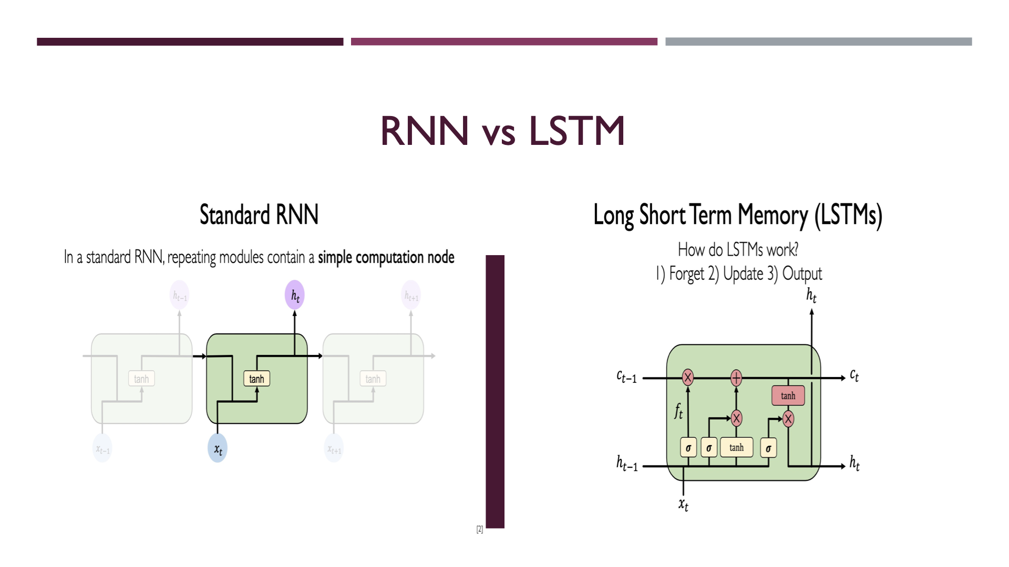
Ct-1: Cell state (long term memory)
Ht-1: Hidden State ( Short term memory)
Xt: Input

Slide 11
Model Accuracy
Accuracy | RNN | LSTM
VIX | 0.9918 | 0.9609
Z3 | 0.9299 | 0.9197

Slide 12
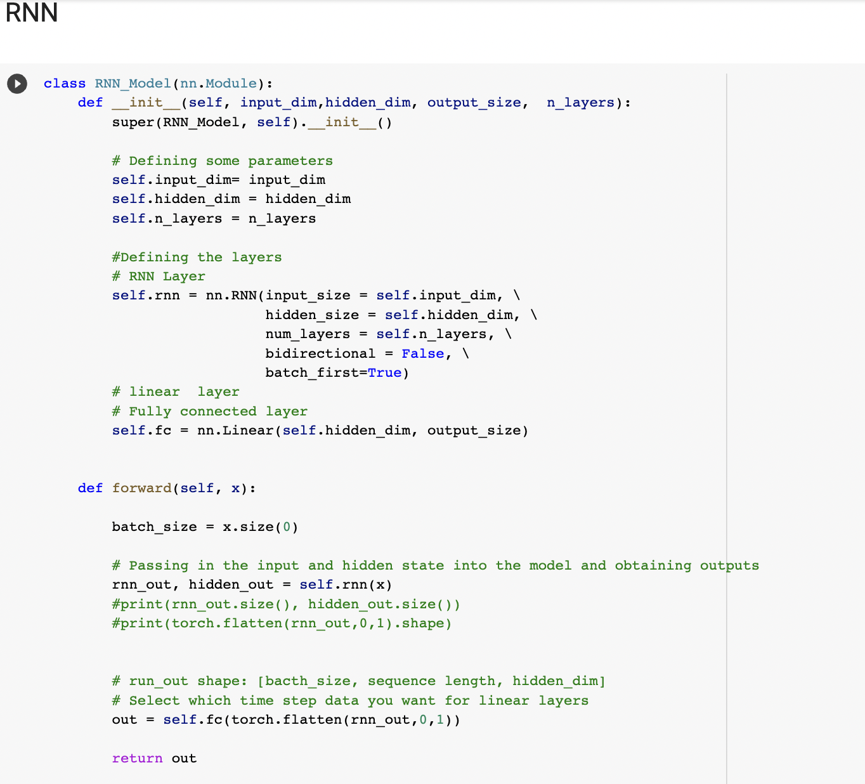
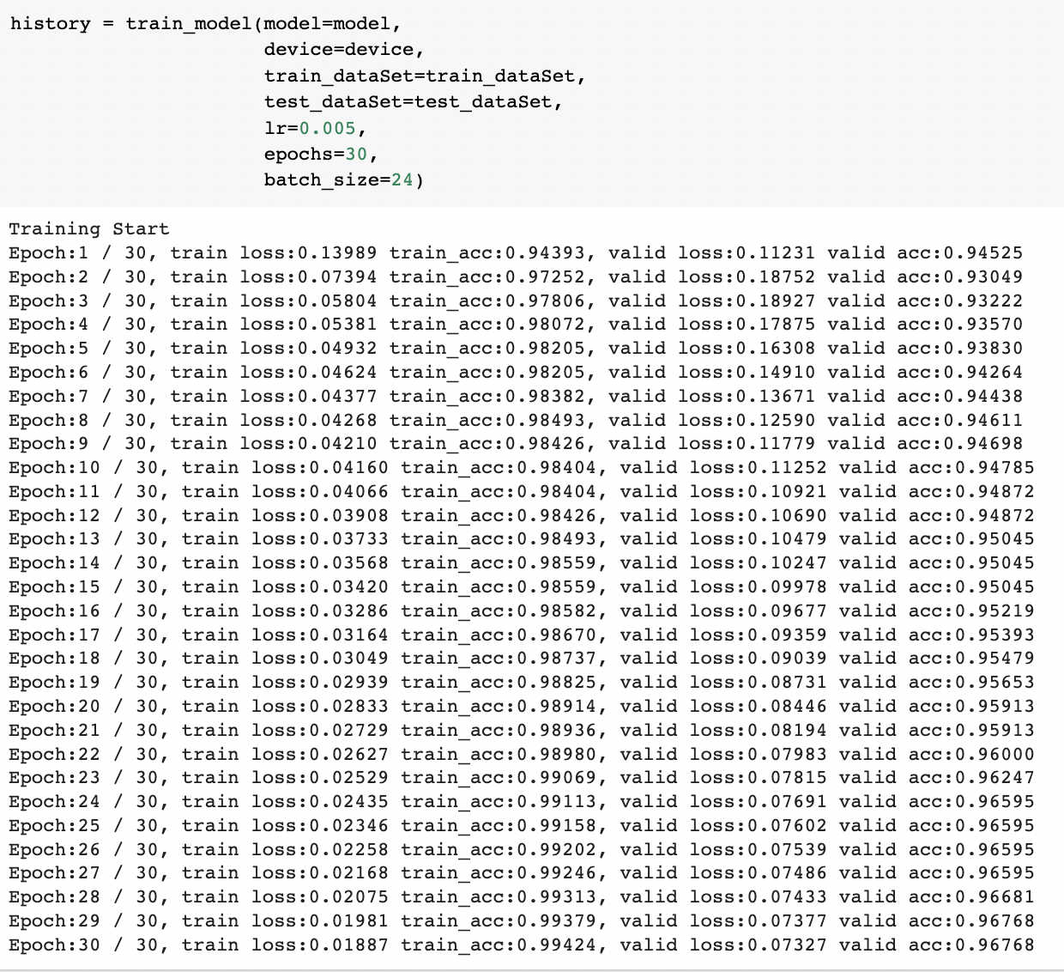
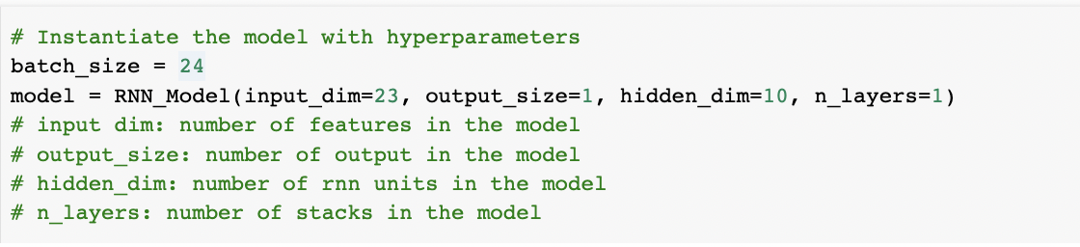
MODEL RESULTS

Slide 13
DATASET & LABELING

Slide 14
LABELING
VIX
Z3

Slide 15
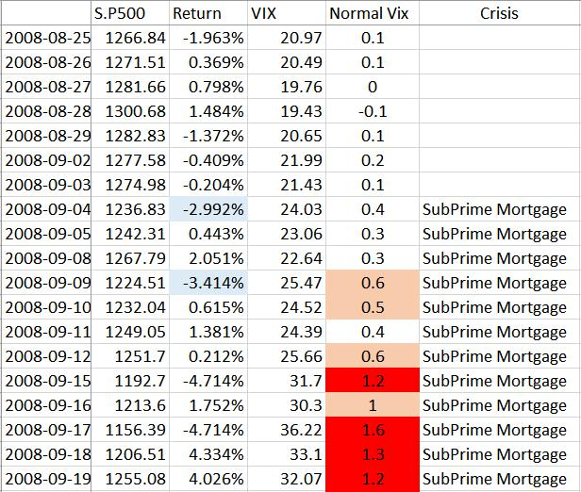
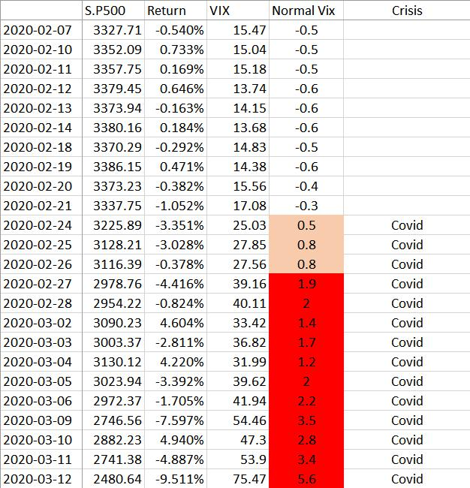
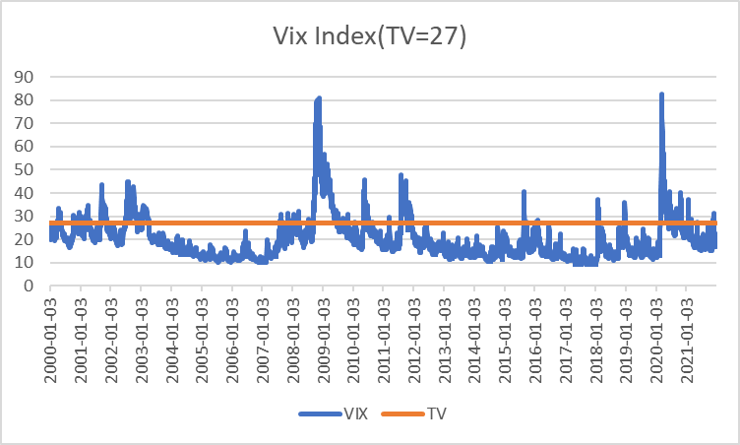
Output Labeling- VIX
Notes:
Seems too small. The prof might say I can’t see. I hope you make two or three slides

Slide 16
Output Labeling - Z3
FE570(Market Micro Structure) provides empirical properties about the market
Volatility Clustering -> High-volatility tend to cluster in Time
Gain/Loss asymmetry -> Large loss observed, but observed gain not as large as loss
Leverage effect -> Volatility is negatively correlated with Return
Make the indicator to detect High Vol and Low Return market

Slide 17
Output Labeling - Z3
 | Low Volatility | High Volatility
BULL Market | Normal | Normal
BEAR Market | Normal | Abnormal Regime
Decision Tool : Draw Down for 10 days for either bull or bear
Standard Deviation for 15 days for Volatility

Slide 18
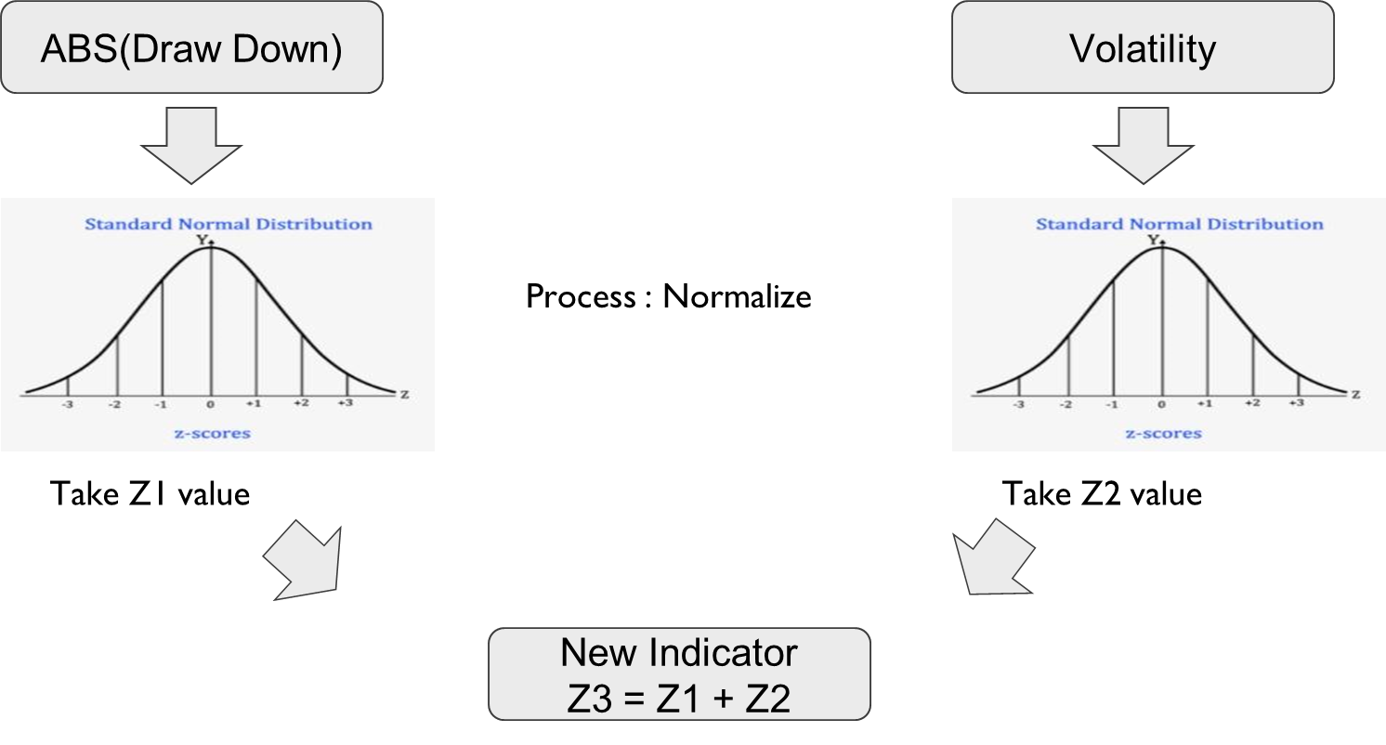
Output Labeling - Z3

Slide 19
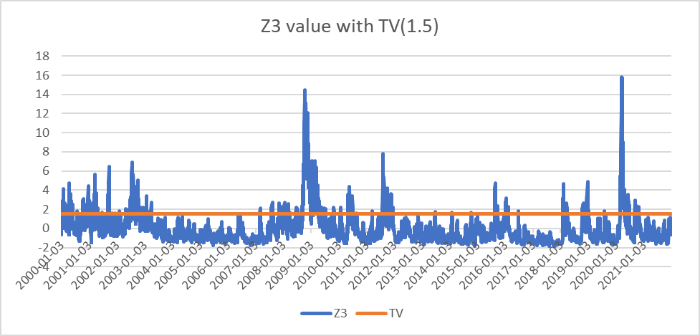
Output Labeling - Z3

Slide 20
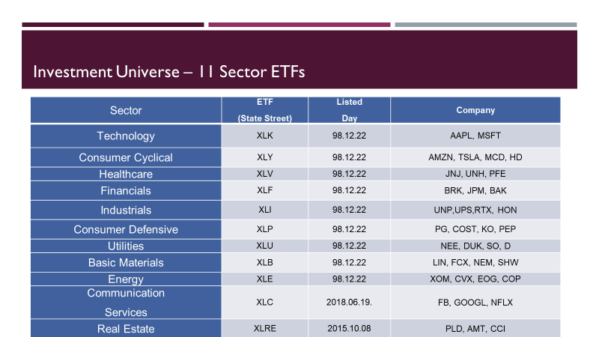

Slide 21
Optimization - Objective Function
When regime is normal
Max ρ^{T}ω − λ(ω − ω_{p})^{T} Σ (ω − ω_{p}) s.t Sum(ωi) = 1, ωi ≤ 0.33, Target Beta = 1
When regime is volatile(Beta Neutral Strategy - Long Short)
Max ρ^{T}ω − ω^{T} Σ ω
s.t Sum(ωi) = 1, -0.66 ≤ ωi ≤ 0.66, Target Beta = 0
ρ : Return vector ω_{p} : Previous weight vector Σ : Covariance Matrix
Notes:
Capturing the overleaf does not look good

Slide 22
Estimation Mean & Covariance
Factor Model - French Fama 3 factor model
Return = α + β1 x Momentum factor + β2 x Size factor + β3 x Value Factor + Rf + ε
-Momentum factor : Market return(SPY) - Risk free rate
-R_SMB : Size Factor : Small company - Big company
-R_HML : Value Factor : High valued company - Low valued company

Slide 23
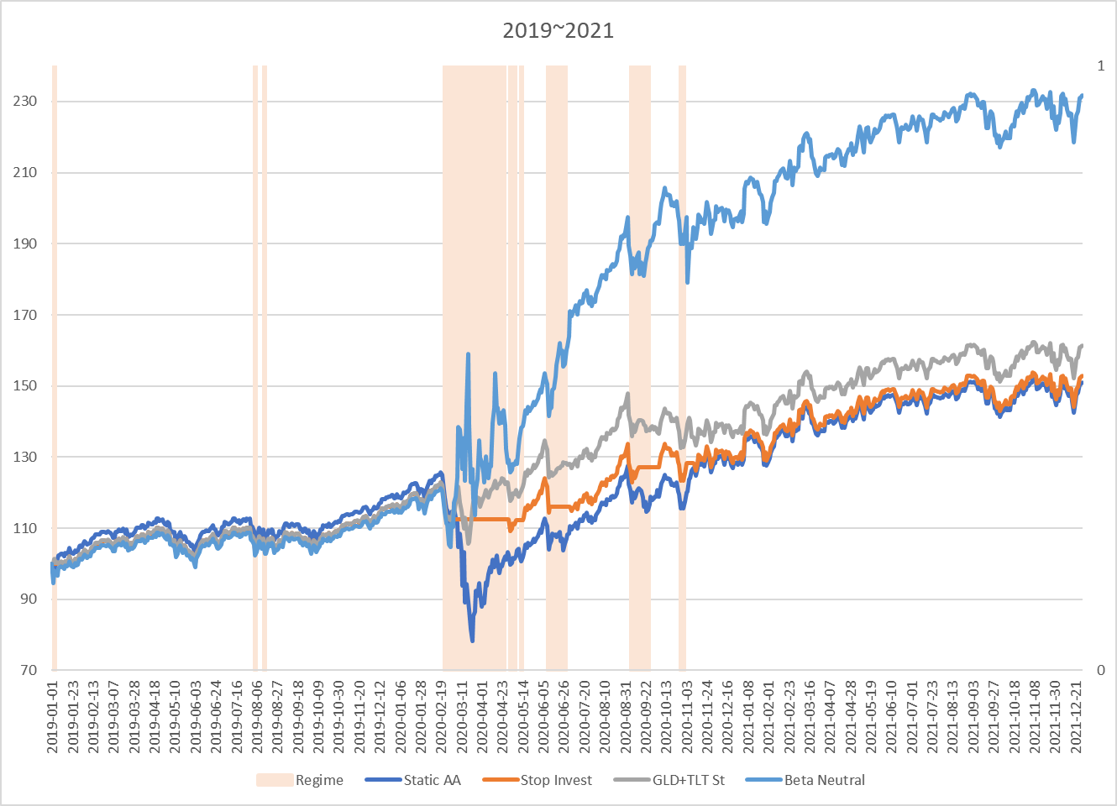
Static Asset Allocation vs Dynamic Asset Allocation
2019~2021

Slide 24
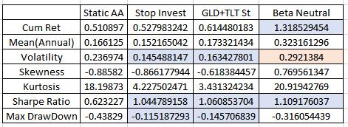
Table - 2019~2021
We should varies the strategy according to the characteristic of fund, risk appetite.
For example, open-end fund should use Stop Inv and GLD+TLT,
closed-end fund goes well with BetaNeutral

Slide 25
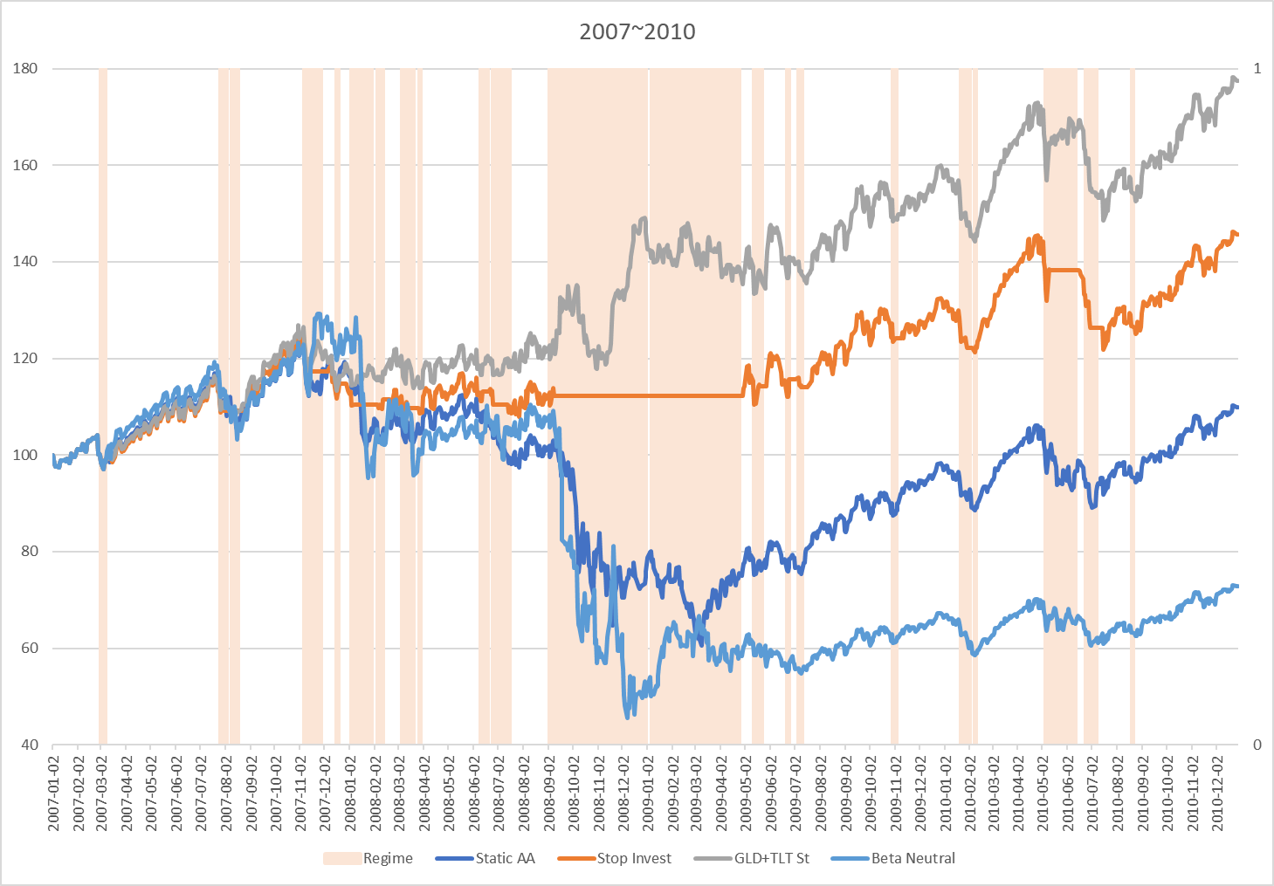
Static Asset Allocation vs Dynamic Asset Allocation
2007~2010

Slide 26
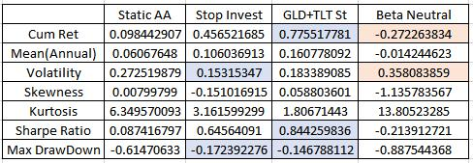
Table - 2007~2010
Beta Neutral Startegy(Long-Short) can not guarantee the better performance

Slide 27


